Slide 1


Social Buzz
Created by Rishabh K
Last Updated 21st Sept 2024

Slide 2


Today's agenda
Project recap
Problem
The Analytics team
Process
Insights
Summary

Slide 3

Social Buzzxxx
Social Buzz, a rapidly expanding tech unicorn, requires agile adaptation to its global scale. Accenture has initiated a three-month proof of concept (POC) to address these key challenge
An audit of their big data practice
Recommendations for a successful IPO
Identification of top 5 content categories.
Project Recap

Slide 4


Problem
Over 100,000 posts per day
36,500,000 pieces of content per year!
But how to capitalize on it when there is so much?
Analysis to find Social Buzz's top 5 most popular categories of content

Slide 5



Andrew Fleming
Chief Technical Architect
The Analytics team
Marcus Rompton Senior Principle
Rishabh Karade
Data Analyst

Slide 6
Process
1 Data Understanding
2 Data Cleaning
3 Data Modelling
4 Data Analysis
5 Uncover Insights

Slide 7

Insights
16
UNIQUE CATEGORIES
1897
REACTIONS TO “ANIMAL” POSTS
January
MONTH WITH MOST POSTS

Slide 8
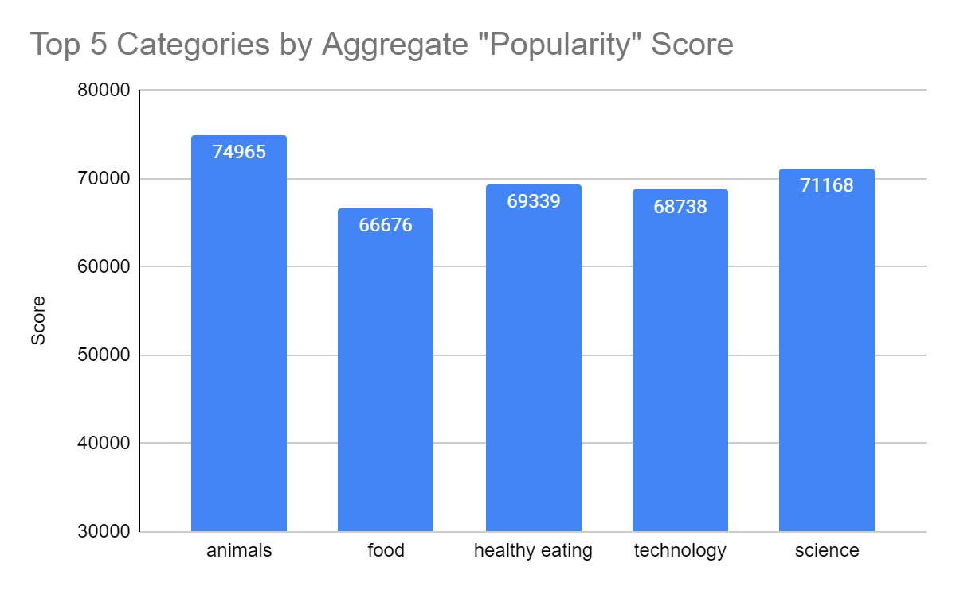

Slide 9
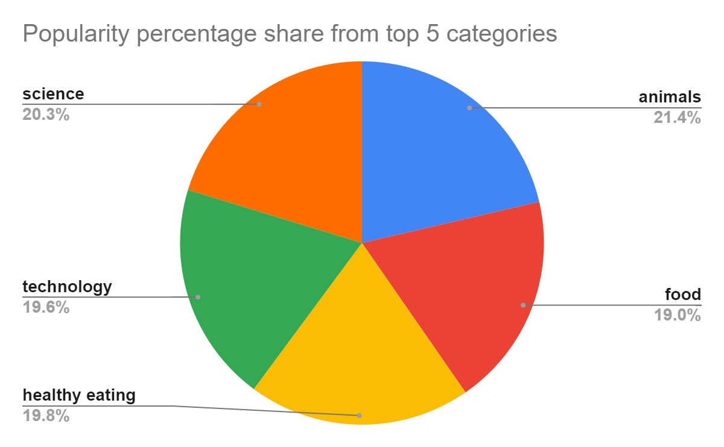

Slide 10

ANALYSIS
Animals and science are the two most popular categories of content, showing that people enjoy "real-life" and "factual" content the most.
INSIGHT
Food is a common theme with the top 5 categories with "Healthy Eating" ranking the highest. This may give an indication to the audience within your user base. You could use this insight to create a campaign and work with healthy eating brands to boost user engagement.
NEXT STEPS
This ad-hoc analysis is insightful, but it's time to take this analysis into large scale production for real-time understanding of your business. We can show you how to do this.
Summary

Slide 11

Thank you!
ANY QUESTIONS?

